Slide 1


SMART INDIA HACKATHON 2025
Problem Statement ID – SIH25116
Problem Statement Title – An Intelligent Energy Saver & Monitoring System (IoT + ML for Classrooms & Offices)
Theme – Sustainable Energy
PS Category – Hardware
Team ID – 112433
Team Name – CodeMinds X

Slide 2

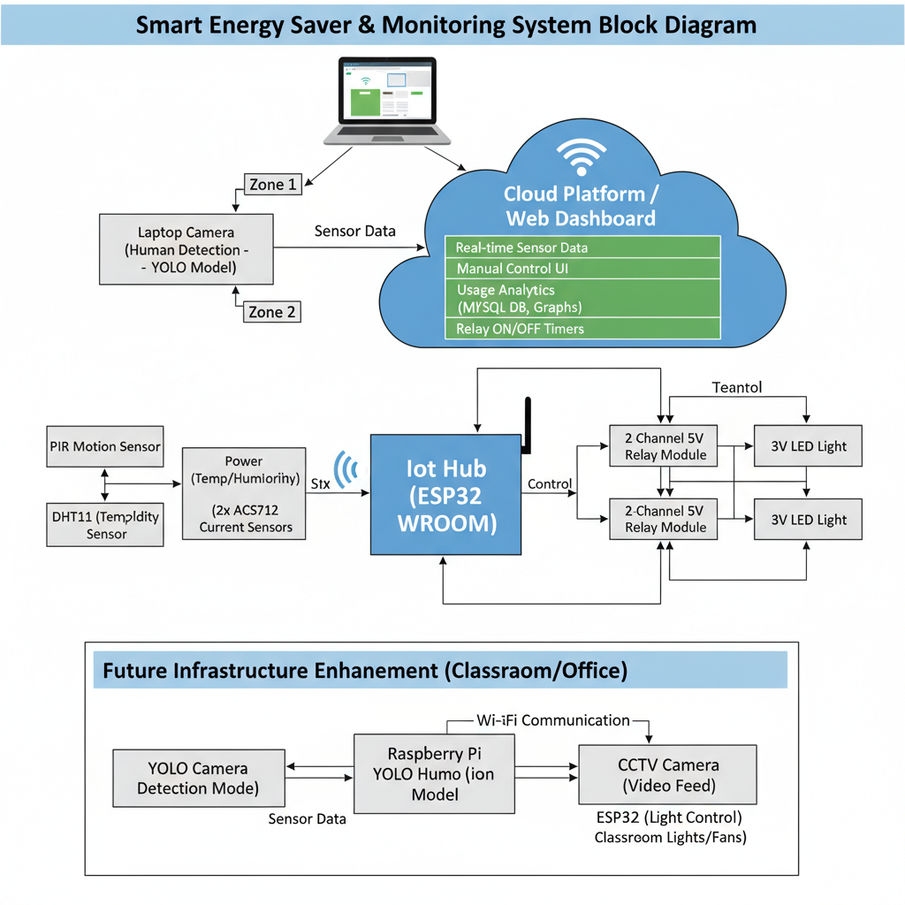
Green Switch: Smart Energy Saver and Monitoring
Millions of classrooms, offices, and industrial spaces waste electricity daily because lights, fans and other appliances are left ON without monitoring. This leads to high electricity bills and increased CO₂ emissions, harming the environment.
Develop a smart IoT and AI-powered system that intelligently monitors human presence, automates lights and fans zone-wise, delivers real-time energy analytics, and drives substantial cost savings and CO₂ reduction for classrooms, offices, and industries.
Problem Statement
Proposed solution
Zone-based human detection for precise control. Real-time IoT + AI/ML automation. Dashboard with live monitoring and analytics. Designed for high-energy spaces (classrooms/offices/industries). Uses existing cameras, reducing hardware cost.
Innovation and Uniqueness

Slide 3
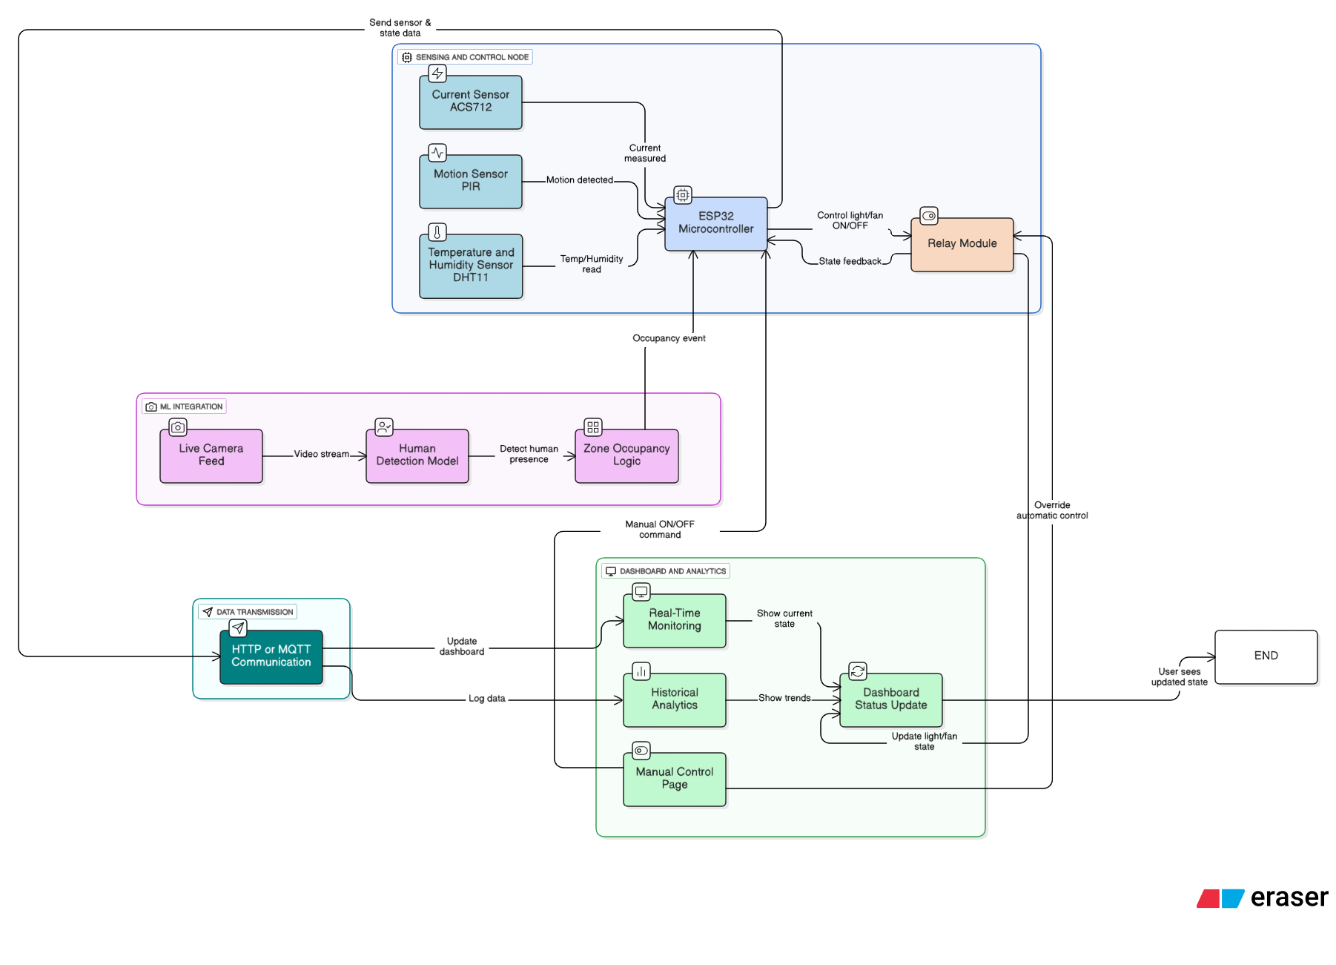
TECHNICAL APPROACH
Component | Technologies / Tools | Purpose / Function
Hardware | ESP32 WROOM | IoT controller / Node
 | PIR Sensor | Detect motion / occupancy
 | DHT11 Sensor | Measure temperature & humidity
 | 2-Channel Relay Module | Control appliances (lights/fans)
 | ACS712 Sensors (x2) | Measure current consumption of each appliance
 | Camera | Provides input for human detection / ML model
Backend | Flask (Python) | Web server handling API requests
 | MySQL | Store sensor data, usage history, and analytics
 | Socket.IO | Real-time communication between node & dashboard
 | REST APIs | Data exchange between frontend and backend
Frontend | HTML5/CSS3/JavaScript | Web interface for dashboard
 | Tailwind CSS | Clean, responsive UI
 | Chart.js | Visualize historical data and trends
 | Socket.IO | Real-time updates for dashboard
Machine Learning | YOLOv8 | Detect humans in camera feed
 | OpenCV | Computer vision processing
 | PyTorch | ML model framework
 | Real-time Object Tracking | Identify occupancy in defined zones
Methodology / Flow | Sensor Node → Backend → Dashboard → ML Feedback | - Motion/temperature/current sensed by ESP32 node - Data sent via REST / Socket.IO - Dashboard shows real-time & historical analytics - ML detects humans → triggers zone-wise appliance control
Data flow Diagram

Slide 4

FEASIBILITY AND VIABILITY
Technical Feasibility Leverages proven IoT hardware (ESP32, PIR, ACS712, DHT11) and robust open-source frameworks (Flask, YOLOv8, OpenCV, PyTorch) ensuring cost-efficiency and rapid prototyping. System architecture is scalable and modular, enabling seamless integration of additional nodes, appliances, and analytics layers across diverse environments.
Challenges Ensuring high accuracy of human detection in varied lighting and crowded conditions, avoiding false triggers. Guaranteeing secure, reliable real-time operation of IoT devices while handling scalability across hundreds of nodes. ITY
Market Viability Addresses a multi-billion-dollar problem of energy wastage in educational institutions, offices, and industries with an affordable, AI-driven automation system. Provides a unique value proposition by combining real-time IoT monitoring, zone-based AI control, and historical analytics — outperforming traditional automation solutions.
Strategies to Overcome Challenges Deploy advanced ML models with continuous retraining and implement edge-based decision-making for improved detection accuracy. Integrate robust cybersecurity protocols, certified switching hardware, and optimized backend infrastructure to ensure safety, reliability, and scalability. ITY

Slide 5







IMPACT AND BENEFITS
Benefits of Solution
Potential Impact on Target Audience
01
Economic: 20–30% reduction in energy costs, enabling long-term financial savings for organizations.
Institutions & Offices:
Substantial reduction in electricity bills through automated, data-driven energy management.
Environmental: Significant reduction in CO₂ emissions, directly contributing to climate change mitigation.
02
Social: Promotes sustainable practices and creates awareness about responsible energy usage.
Industries: Improved operational efficiency by eliminating human dependency in switching appliances.
Technological: Encourages adoption of AI + IoT-driven smart infrastructure in public and private sectors.
03
Students & Employees: Comfortable, eco-friendly working environment with optimized lighting and fan control.

Slide 6
RESEARCH AND REFERENCES
Title | Summary / Relevance | Link
IoT-Based Smart Energy Management System using PZEM-004t Sensor & Node MCU | A practical implementation using IoT, sensors, relays and power monitoring modules — useful baseline to compare hardware + software aspects. | IJERT Article IJERT
Design and Implementation of Smart Energy Management | Monitors energy consumption (lighting, temperature, humidity, electrical parameters) using IoT; shows real deployment and data acquisition. | PDF Paper LPPM Repository
A Novel Robust Smart Energy Management and Demand Reduction for Smart Homes | Proposes a real-time energy scheduling + IoT-based system, showing methodologies in demand-side control and system architecture. | MDPI Sensors Article MDPI
IoT-Enabled Energy Management Systems for Sustainable Energy Storage: Design, Optimization, and Future Directions | Discusses IoT architectures for energy management, how to optimize, relevant especially for integrating sensors and data flows. | ResearchGate / Publication ResearchGate
IoT-Enabled Smart Energy Management Device for Optimal Operation of DERs | Focuses on IoT maturity and energy cost management — useful for understanding larger-scale systems beyond simple node-level IoT. | ScienceDirect Abstract ScienceDirect
Prototype Model of Smart Energy Meter Utilizing IoT Technology | Demonstrates usage of power sensors and energy measurement modules in IoT systems — good reference for your current sensor parts. | IJCRT PDF IJCRT

